Slide 1
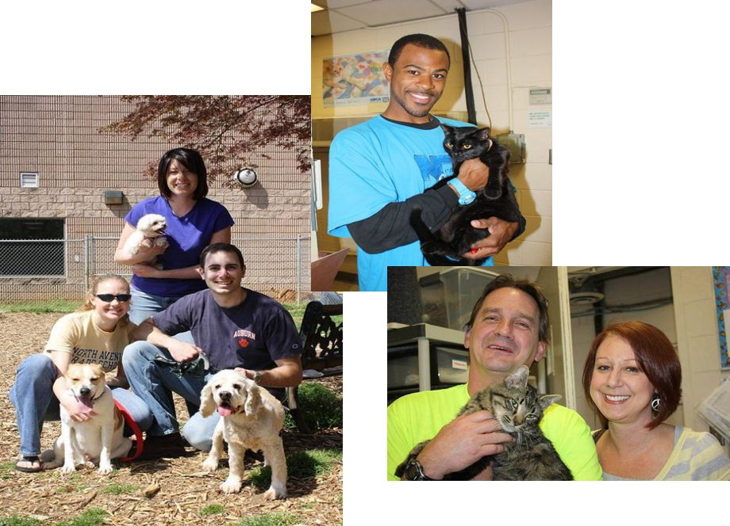
DeKalb Animal Services Task Force
August 2011
Presentation to
DeKalb County
Board of Commissioners
October 18, 2011

Slide 2
DeKalb Comparison in 20 County Region
2005
#2 out of 20 - Cost per animal
#3 out of 20 - Animals impounded
#18 out of 20 - Animals surviving
#19 out of 20 - Adoption rate

Slide 3
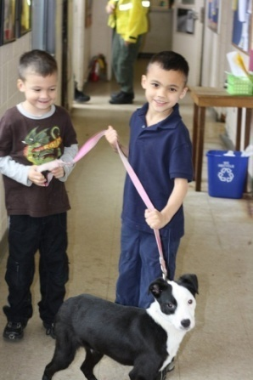
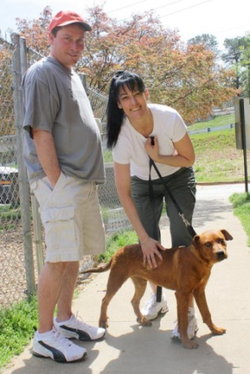
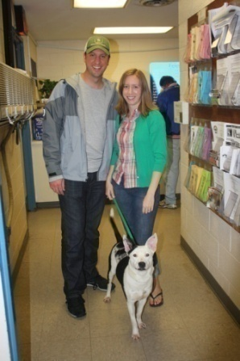
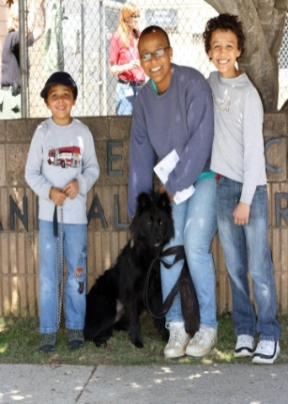
Mission of the Task Force
The DeKalb Animal Services Task Force was established by the DeKalb Governing Authority to identify short and long term strategies that will:
  1. Improve quality of life for animals in DeKalb County
  2. Reduce the numbers of healthy or treatable animals euthanized in the care of DeKalb County

Slide 4
Objectives for Today’s Meeting
Present research efforts to date
Findings and conclusions
National best practices
Recommendations
Next steps

Slide 5
Task Force Research
6 public meetings
Over 25 interviews of current and former staff
Public official and public survey
Reviewed code, mission statement, SOPs
Identified internal and external partners and points of interaction
Observed operations in facility and in the field
Researched best practices of highly successful operations

Slide 6
71% of DeKalb County Households Have Pets
Households with Pets Pet Population
Dogs 102,954 174,911
Cats 89,669 197,328
Total 192,623 372,239
Estimate calculated by formula from the American Veterinary Medical Association. The 2010 Census reports a total of 270, 124 households in DeKalb County.

Slide 7
Findings: Animals Under DeKalb County Care
2008-2010
25,662 Animals Taken into DeKalb Animal Shelter
  3% were found dead in the facility (719)
  7% are unaccounted for (2,370)
  8% were reclaimed by their owners (2,060)
  10% were adopted (2,605)
  12% were taken by rescue groups (3,154)
  60% were euthanized (15,676)

Slide 8
Findings : The Facility
The Facility is a Health and Safety Hazard to Humans and Animals
Major problems with pests
Air conditioning, temporary unit and generators used, costing $115,000 each year
Standing water – promotes spread of disease as well as growth of bacteria and mold
No hot or pressurized water for cleaning
Drains constantly clogged
Odor is overwhelming

Slide 9
Findings : The Facility
Design not supportive of function or scale of operation
Appearance, location, conditions, noise and smell undermine public interest, employee morale and volunteer recruitment

Slide 10
Findings: Kennel
Kennel care function marginalized at every level
Animal cages often filthy -- urine and feces in food/water bowls
Major problem with pests
Staffing level in kennel too low
Insufficient staffing and poor communications occasionally lead to animals left without food/water and untreated for injuries/illness
The demoralizing effects on the staff of the conditions and the use of euthanasia lead to poor morale and a desire to separate themselves from the animals

Slide 11
Findings : Enforcement
Highlight of Animal Services function
Cruelty Investigation Unit unique in State
Animal cruelty is a gateway crime and a tell-tale sign of domestic abuse and other criminal behavior
Frequent reports from public of slow or no response
Occasional reports from the public of threatening behavior

Slide 12
Findings: Staffing
Employment by Type
Number of Employees
Adoption 1
Cruelty 3
Administration 9
Kennel 10
Field Enforcement 13
Total
Personnel expense 65% of total budget
All positions are full time
Handled ~ 28,000 calls in 2010
Handled ~ 8,500 animals in 2010 (850/person in kennel)
36

Slide 13
Findings: Volunteers
Volunteer service a tremendous resource in other places
Facility conditions and extensive practice of euthanasia a barrier to recruitment in DeKalb
Insufficient staffing levels prevent ability to provide training and supervision to volunteers

Slide 14
Findings: Partners
Public Safety/Police
Facilities Department
Purchasing Department
District Attorney
Solicitor General
Recorder’s Court
Health Department
Code Enforcement
Sanitation
Fleet Management
Human Resources
DeKalb Municipalities
State of Georgia, Department of Agriculture
Hospital Systems
Rescue Groups

Slide 15
National Survey Results for High Performers
      Tompkins County, Ithaca, New York
      Travis County, Austin, Texas
      Washoe County, Reno, Nevada
      Richmond, Virginia

Slide 16
Best Practices of Highly Successful Shelters
Leadership
New Resources
Public Relations
Community Engagement
Volunteers
Feral Cat Trap/Neuter/Return
High Volume, Low Cost Spay and Neuter
Prevention
Technology
Shelter Care
  Medical
  Behavioral
Home-Finding
  Proactive Redemption
  Adoption
  Foster Care
  Rescue Groups
  Retention

Slide 17
Recommendations: Change in Intent!
New Philosophy
Reactive Posture
Proactive Mindset
Euthanasia Strategy
Life-Saving Mission
Warehousing Function
Home Finding Solutions
New Purpose
New Place
Operational Policy and Practices
Correct Existing Conditions
Best Practices
Health & Safety for All
Attractive to Public & Volunteers
Partnership with DeKalb Schools

Slide 18
Recommendations: Facility
New facility or renovated facility (permanent solution)
  Appropriate design and construction materials
  Space which reflects new mission
  Location, location, location
Make wholesale improvements to existing facility (interim step)
  Implement best practices in sheltering animals
  Establish new protocols for maintenance
  Permanent air conditioning system for kennel area
Make immediate provision for significant maintenance to current facility (interim step)
Consider satellite adoption facilities in market-conscious locations (interim/permanent step)

Slide 19
Recommendations: Funding
    New or expanded sources of revenue:
      Increase license fee structure (above current fees of $5 for altered, $15 for unaltered pets)
      Increase license fee collections (<10% registered currently)
      Increase citation collections ($63,719 in 2010)
      Increase adoption fees associated with dramatic increase in adoptions
      New service fees associated with low cost veterinary services
      New funding from private foundations and grants when lifesaving becomes intent and improvements are made

Slide 20
Recommendations: Policy
Incorporate lifesaving and quality of life in mission
Incentivize owners to spay and neuter pets
Incentivize good owner behavior
Allow for increased number of household pets
Improve effectiveness of enforcement through technical changes to code
Strengthen bite quarantine provisions

Slide 21
Recommendations: Operations
Change hours and days of operation for public convenience
Improve response times to public calls
Adopt policies that promote adoption, reclaim and rescue
Add staffing to emphasize adoption and animal care
Increase role of volunteers
Increase convictions for cruelty and code violations
Increase citizen education
Change SOPs and conduct staff training program
Cross train all staff
Upgrade technology equipment and software and conduct staff training

Slide 22
Next Steps
Short Term (Less than 1 Year)
  Major maintenance and cleaning of facility
  Adopt policy changes to reflect new lifesaving mission
  Adopt changes to fee structure and increase collections
  Install HVAC unit and end practice of leasing air conditioning for kennel
  Establish new SOPs based on best practices
  Establish DeKalb Improves the Lives of Animals (DILA) Oversight Committee
  Revise code provisions to reflect new mission
  Begin public education programs
  Complete Final Report
Intermediate Term (1-3 Years)
  Identify funding for new facility at new location
  Consider value associated with outsourcing

Slide 23
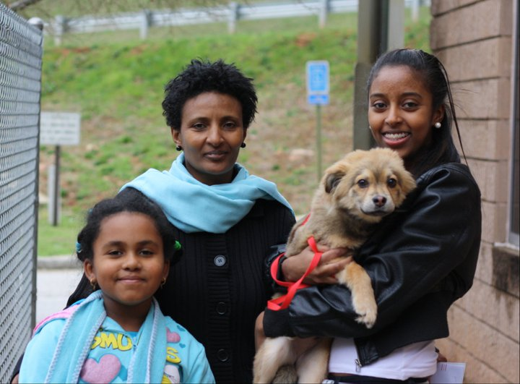
“No army can withstand the strength of an idea whose time has come.”
Victor Hugo
www.dekalbcountyga.gov/astf
dila@dekalbcountyga.gov

